Slide 1
Preprocessing
Lab 2

Slide 2
Data Preprocessing
Data preprocessing involves transforming raw data to well-formed data sets so that data mining analytics can be applied.

Slide 3
How to Handle Missing Data (Data Cleaning)?
Ignore the tuple
Fill in the missing value manually
Fill in it automatically with
a global constant : e.g., “unknown”, a new class?!
the attribute mean
the attribute mean for all samples belonging to the same class: smarter

Slide 4
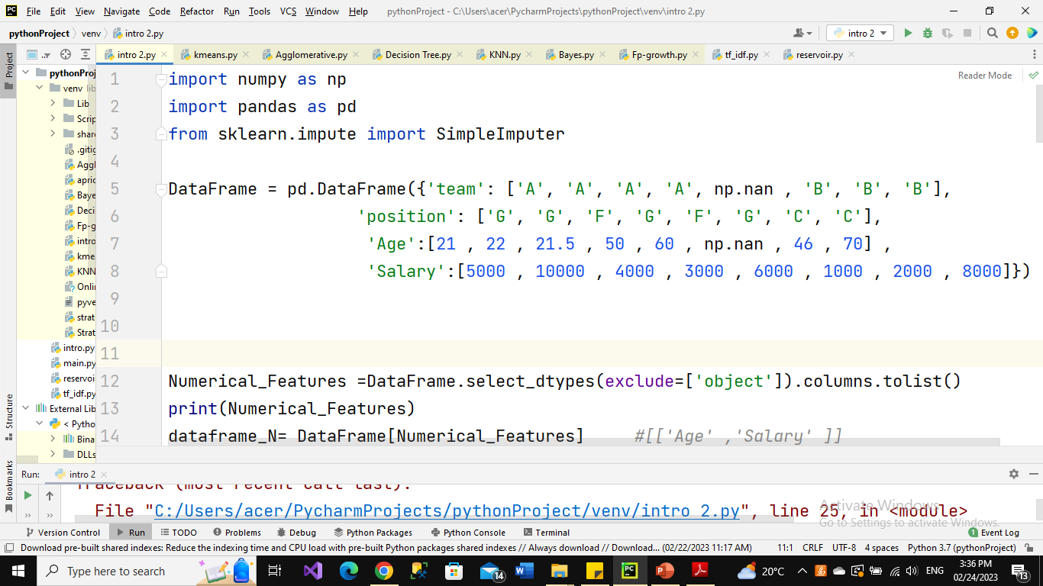
Missing Data
Handing Missing values by calculating mean value for the rest of values in the same column for Numerical feature and most frequent category for Categorical features

Slide 5
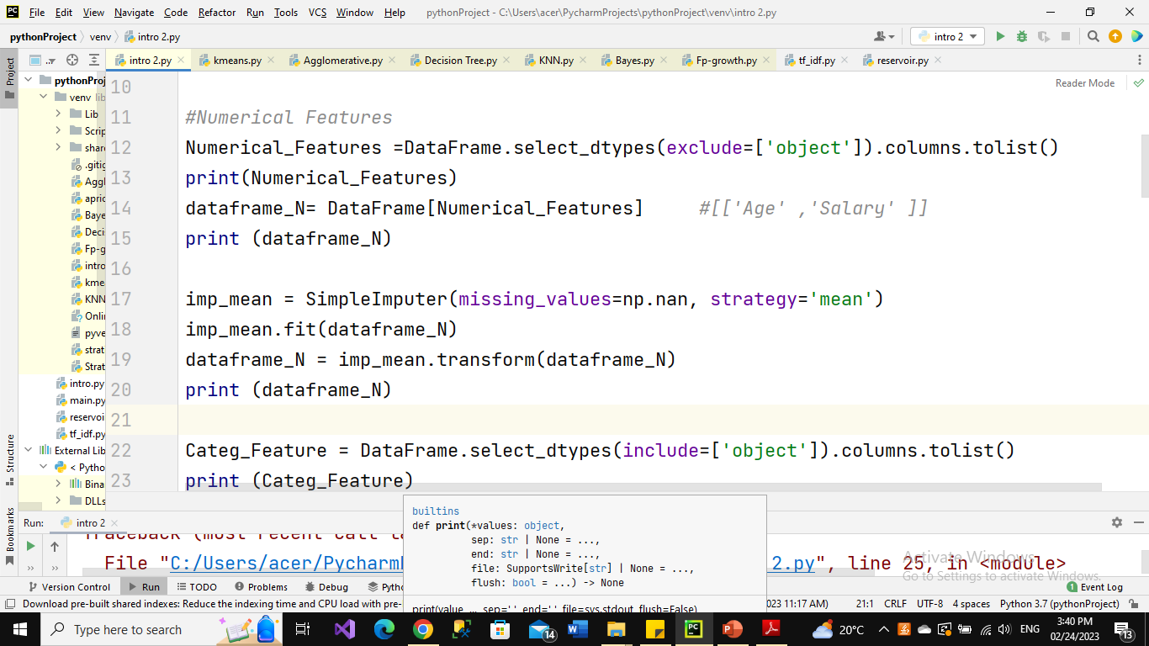
Missing Data

Slide 6
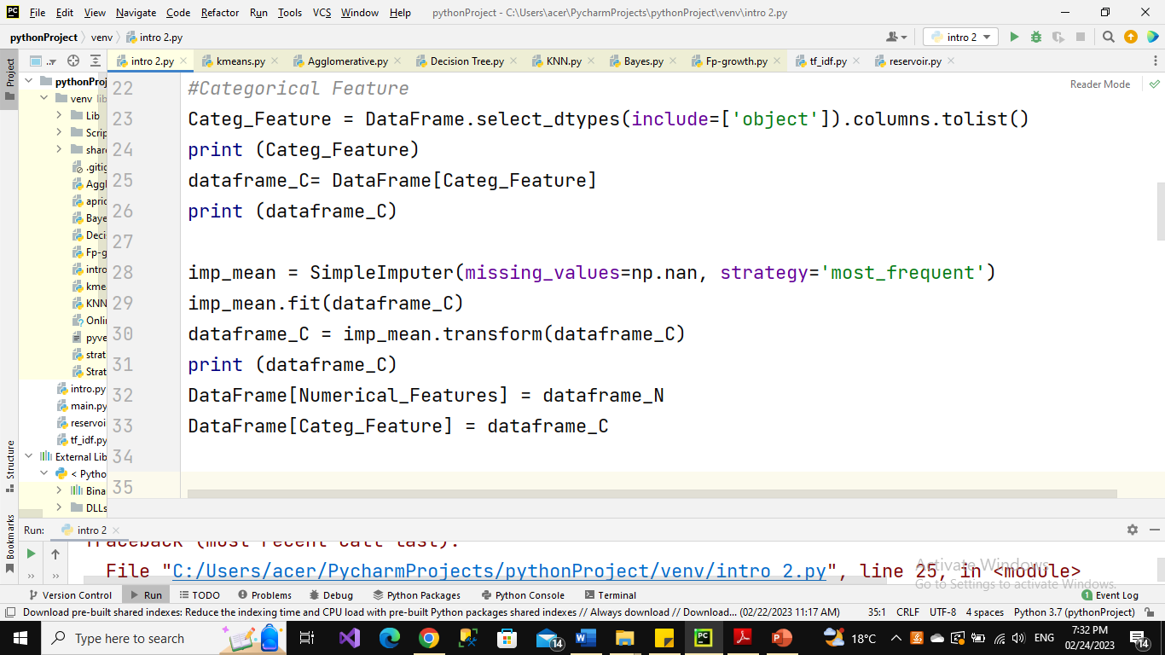
Missing Data

Slide 7
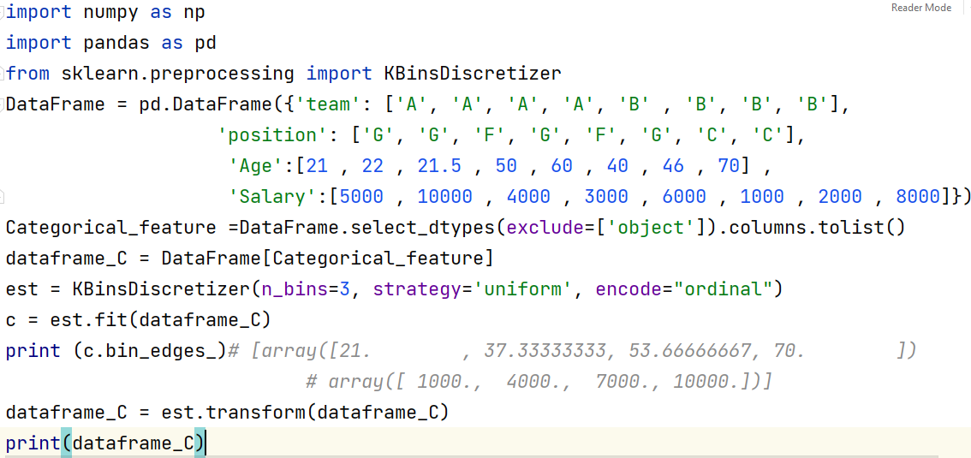
Data Transformation (Discretization)
Discretization
Notes:
encode{‘onehot’, ‘onehot-dense’, ‘ordinal’}, default=’onehot’Method used to encode the transformed result.
‘onehot’: Encode the transformed result with one-hot encoding and return a sparse matrix. Ignored features are always stacked to the right.
‘onehot-dense’: Encode the transformed result with one-hot encoding and return a dense array. Ignored features are always stacked to the right.
‘ordinal’: Return the bin identifier encoded as an integer value.
strategy{‘uniform’, ‘quantile’, ‘kmeans’}, default=’quantile’Strategy used to define the widths of the bins.
‘uniform’: All bins in each feature have identical widths.
‘quantile’: All bins in each feature have the same number of points.

Slide 8
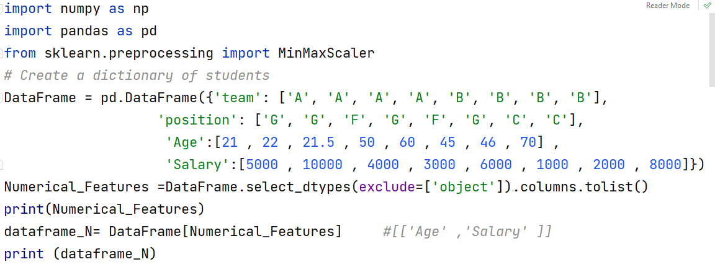
Data Transformation
Normalization (MinMaxScaler)

Slide 9
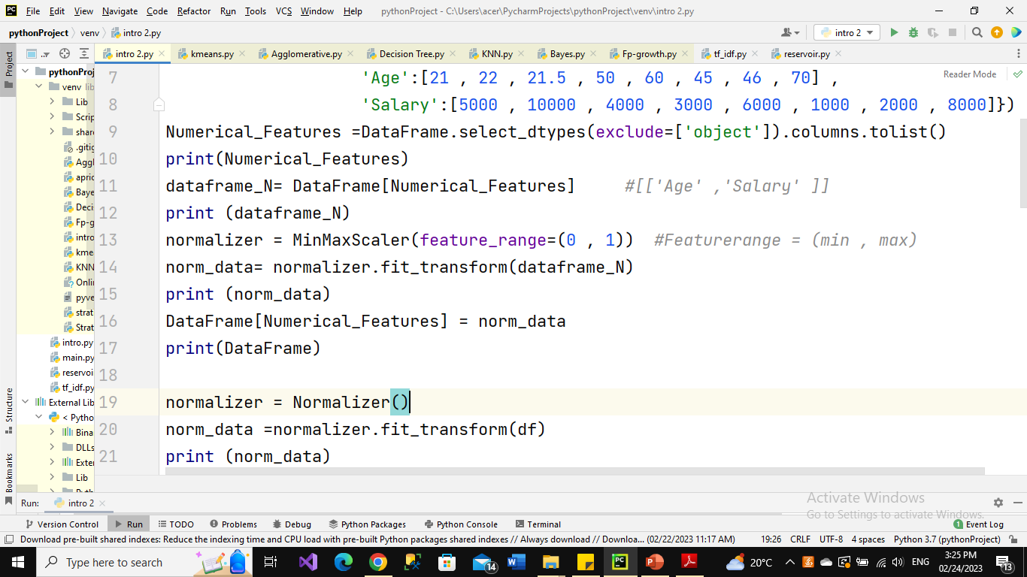
Data Transformation
Normalization (MinMaxScaler) Cont.

Slide 10
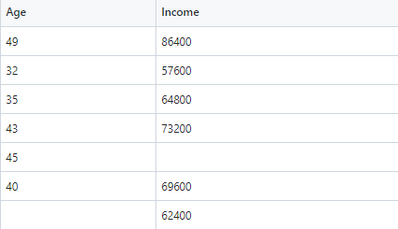
Assignment.
Apply Data Cleaning and Normalization to the following data

